Slide 1
Cloud computing
By: Benas Jasilionis , Zain Badshah , Mohamed, Iwan , Abubakar Shariffali , James

Slide 2
Contents
What is Cloud computing
History of Cloud computing
What are the benefit of Cloud computing
Benefits of using the Cloud for business
What is AWS
Who are some of the other leaders in Cloud technology
Different types of Cloud
Types of Cloud services
Operational expenditure VS Capital expenditure
Examples of companies that use the Cloud
Summary

Slide 3
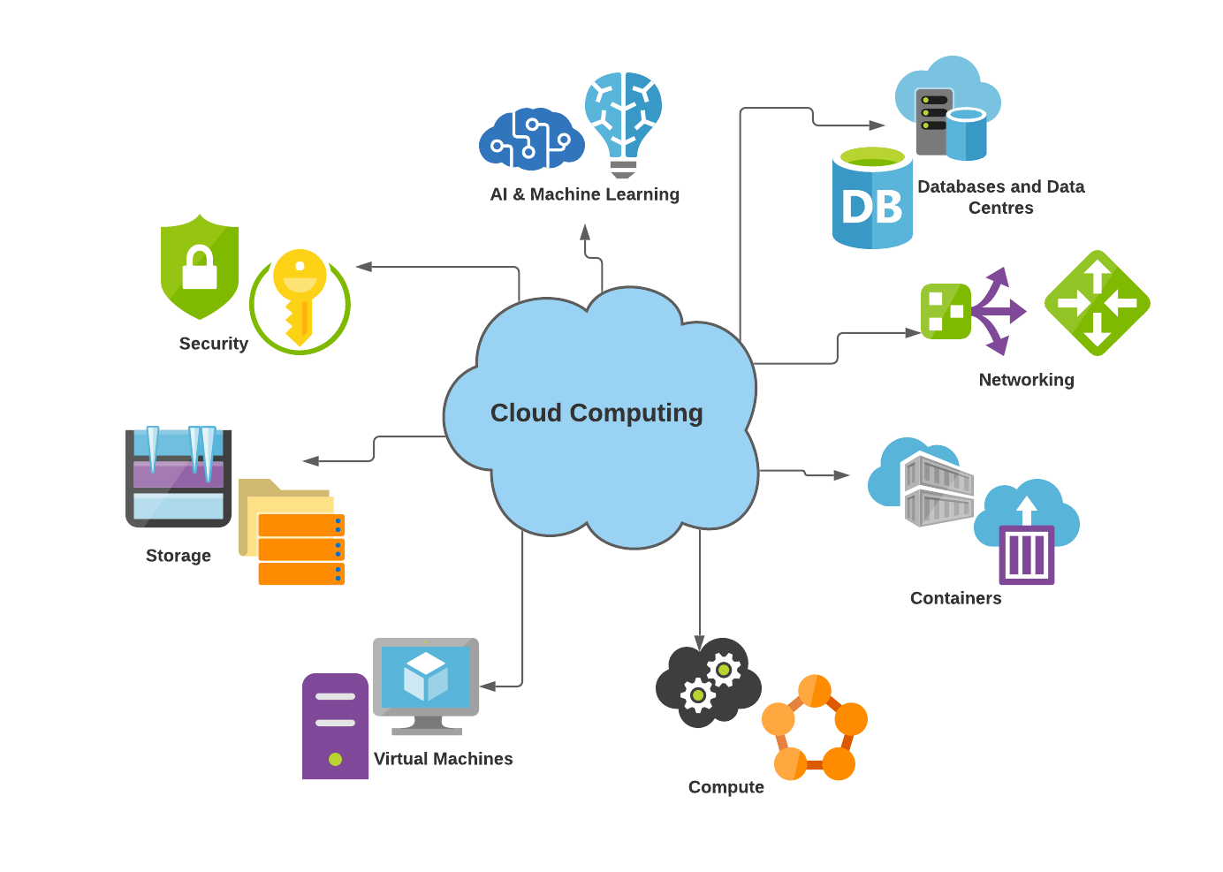
WHat is cloud computing?
Cloud computing is the availability of computing resources over the internet
Datacenters are connected to end users
Wide variety of uses, in particular data storage where 60% of corporate data is now on the cloud
Benefits include economies of scale, reduced capital expenditure, security, scalability, reliability , productivity and speed.
Cloud computing also provides services to the internet of things (IoT)

Slide 4
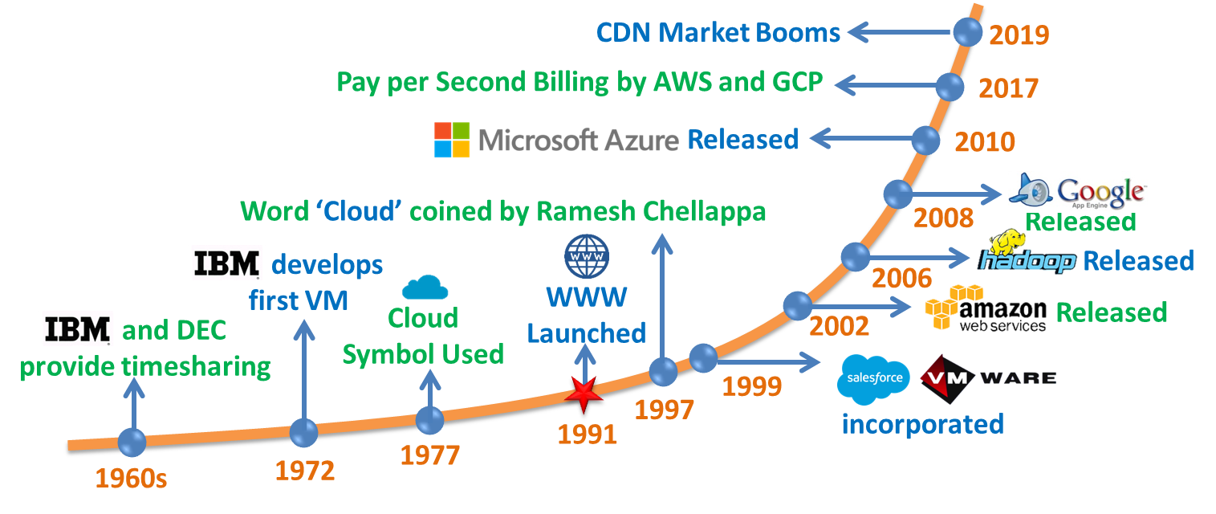
History of cloud computing

Slide 5
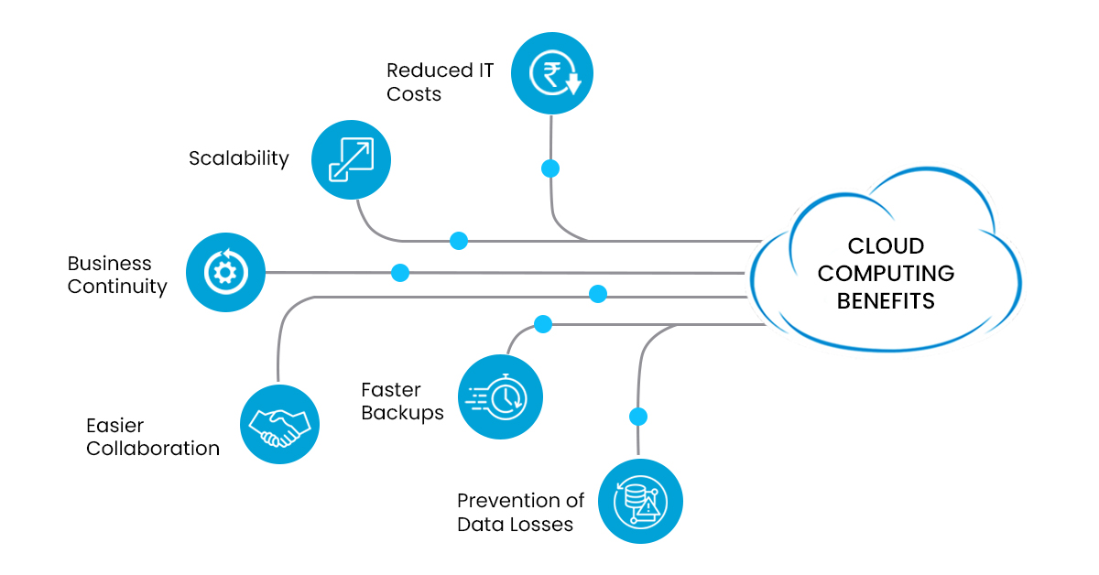
What are the benefits of cloud computing

Slide 6
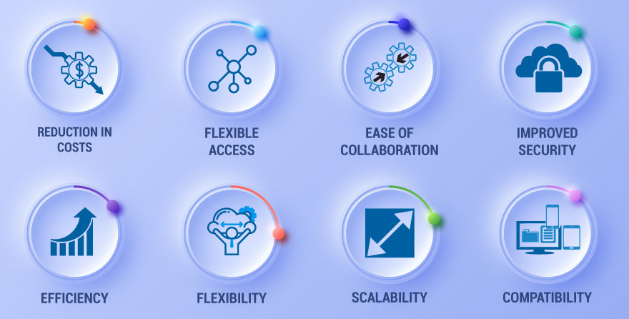
Benefits of using the cloud for a business

Slide 7

What is AWS?
History of AWS

Slide 8
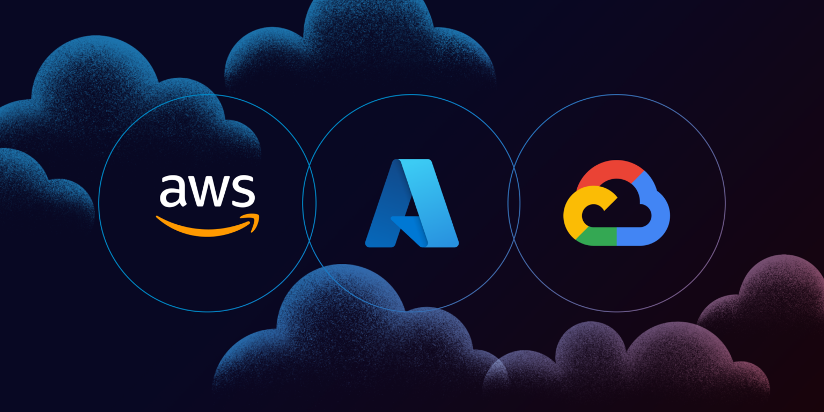
Who are some of the other leaders in Cloud technology?

Slide 9

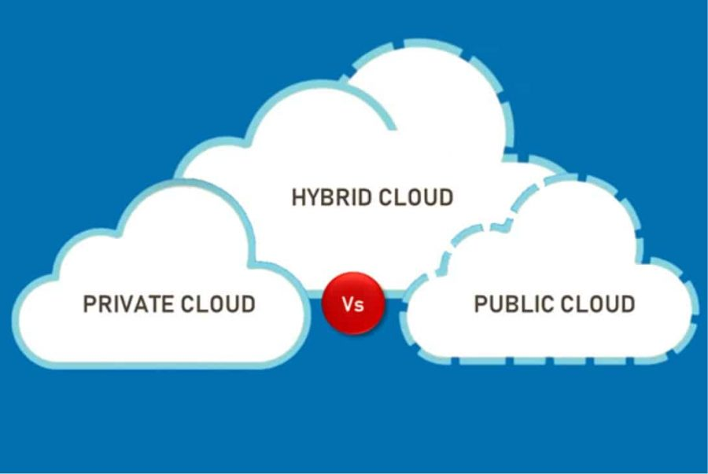


Different types of cloud

Slide 10
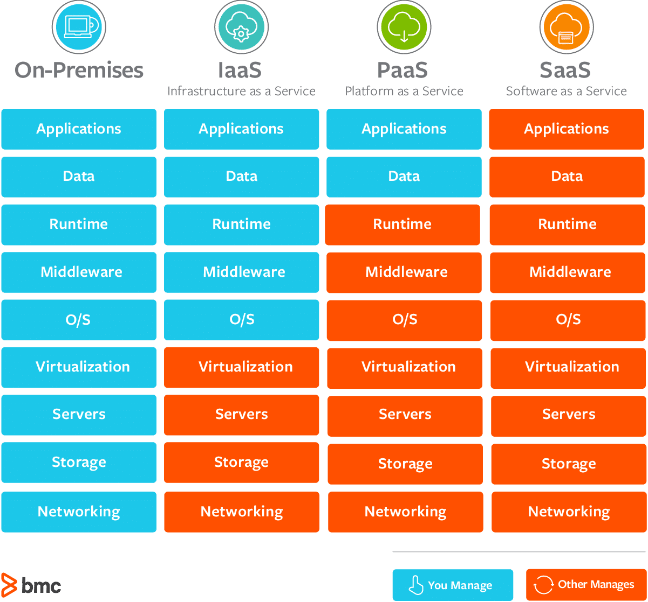
Types of cloud services

Slide 11

operational expenditure vs capital expenditure
CapEx – Costs of long-term investments
OpEx – Cost of day-to-day operations

Slide 12





EXAMPLES OF COMPANIES THAT USE THE CLOUD

Slide 13

SUMMARY
ANY QUESTIONS?

